Slide 1
Software Maintenance

Slide 2
Software maintenance is a task that every development group has to face when the software is delivered to the customer’s site , installed and is operational.
The time and effort required in keeping the software operational is very significant and consumes about 40-70% of the cost of the entire life cycle.

Slide 3
Software maintenance includes:
Error corrections
Enhancement of capabilities
Deletion of obsolete capabilities
Optimization
Aim: Preserve the value of software over time.
The value can be enhanced by
expanding the customer base
meeting additional requirements
becoming easier to use
more efficient and
employing newer technology

Slide 4
Categories of Maintenance:
Corrective Maintenance:
This refers to modifications initiated by defects in the software.
A defect can result from design errors, logic errors and coding errors.
Emergency fixes such as “patching”.
Adaptive Maintenance:
It includes modifying the software to match changes in the ever-changing environment.
Influences such as business rules, government policies, work patterns, software and hardware operating platforms are reponsible.
Eg., When European countries had decided to go for “single European currency”, this change affected all banking system software and was modified accordingly.

Slide 5
Perfective Maintenance:
It means improving processing efficiency or performance, or restructuring the software to improve changeability.
When the software becomes useful, the user tends to experiment with new cases beyond the scope for which it was initially developed.
To make the product better, faster, smaller, better documented, cleaner structured, with more functions.

Slide 6
Other types of Maintenance:
There are long term effects of corrective, adaptive and perfective changes.
This leads to increase in the complexity of the software, which reflect deteriorating structure.
The work is required to be done to maintain it or to reduce it, if possible.
This work may be named as preventive maintenance.

Slide 7
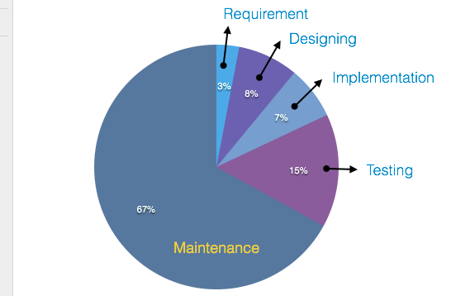
Cost of Maintenance

Slide 8
Real-world factors affecting Maintenance Cost
The standard age of any software is considered up to 10 to 15 years.
Older softwares, which were meant to work on slow machines with less memory and storage capacity cannot keep themselves challenging against newly coming enhanced softwares on modern hardware.
As technology advances, it becomes costly to maintain old software.
Most maintenance engineers are newbie and use trial and error method to rectify problem.
Often, changes made can easily hurt the original structure of the software, making it hard for any subsequent changes.
Changes are often left undocumented which may cause more conflicts in future.

Slide 9
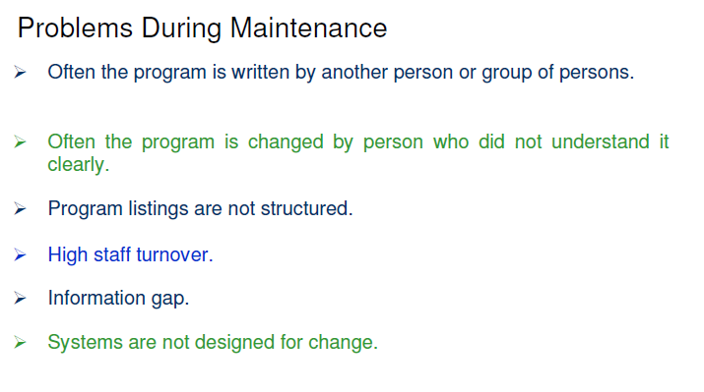

Slide 10
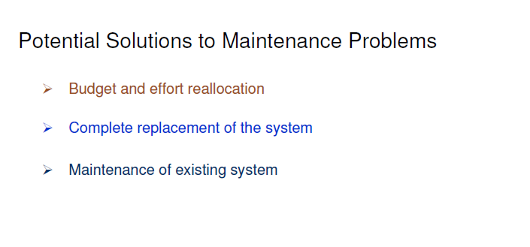

Slide 11
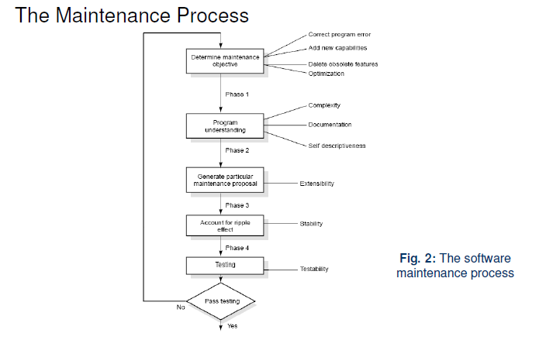

Slide 12
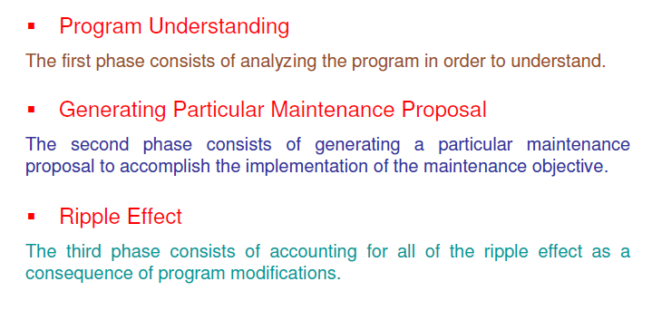

Slide 13
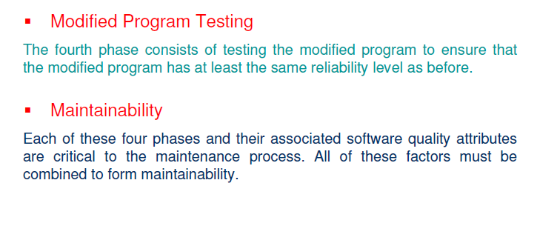

Slide 14
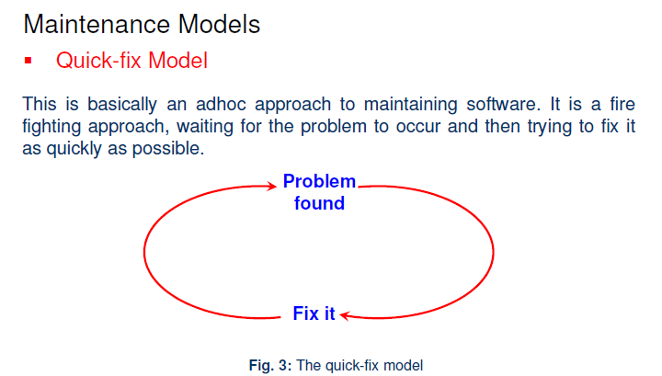

Slide 15
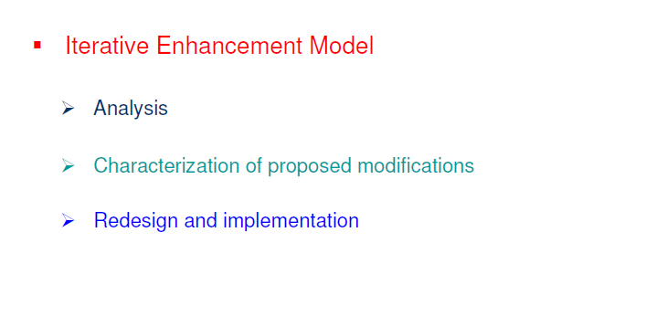

Slide 16
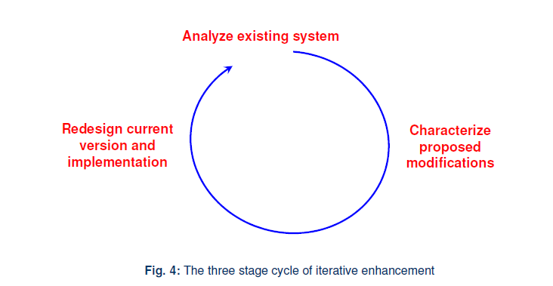

Slide 17
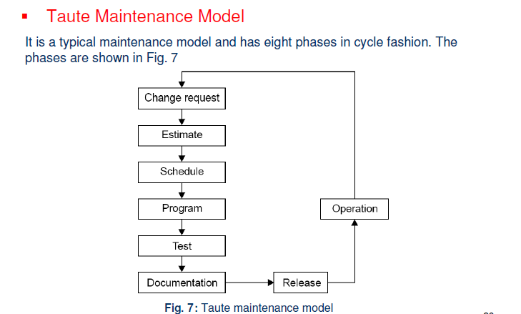

Slide 18
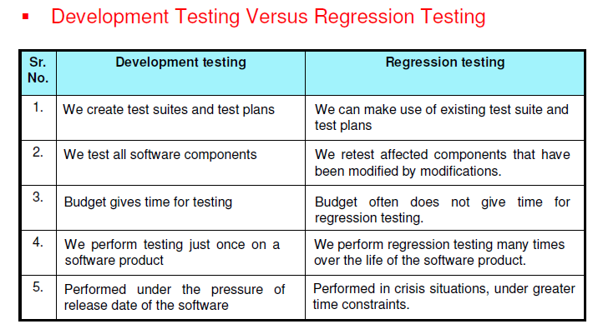

Slide 19
Regression Testing serves many purposes such as to:
increase confidence in the modified program.
locate errors in the modified program
preserve the quality and reliability of software
ensure the software’s continued operation

Slide 20
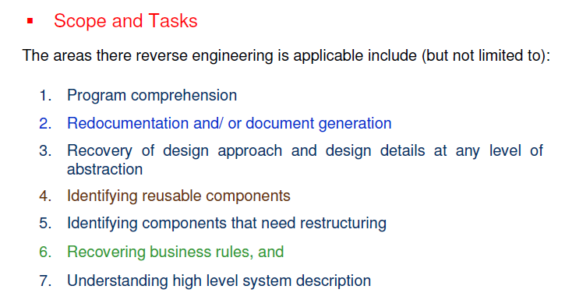
Reverse Engineering:
It is the process followed in order to find unknown and hidden information about a software system.
Notes:
It is becoming important, since several software products lack proper documentation, and are highly unstructured, or their structure has degraded through a series of maintenance efforts.
Maintenance activities cannot be performed without a complete understanding of the software system.u88

Slide 21
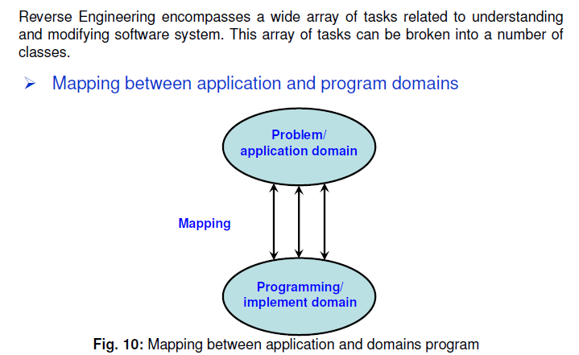

Slide 22
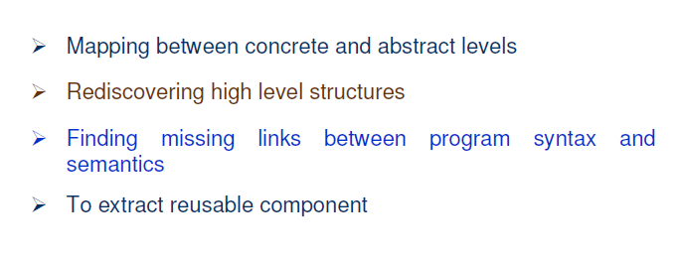

Slide 23
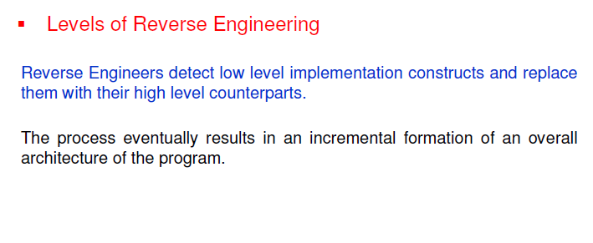

Slide 24
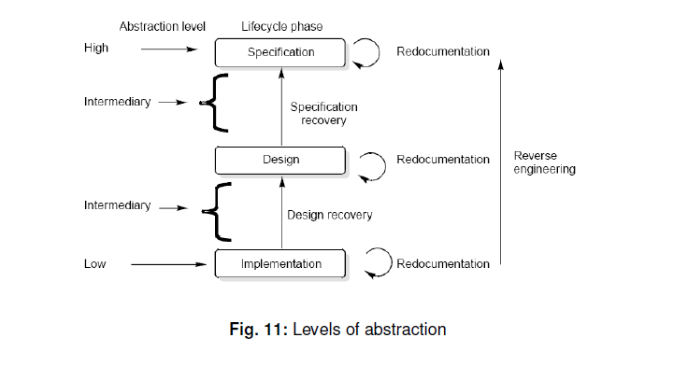

Slide 25
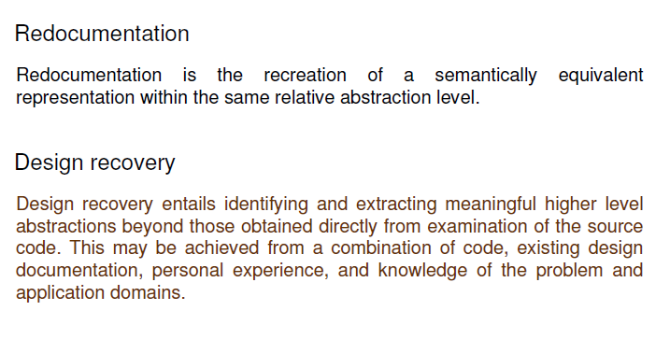
Notes:
In design recovery, the resulting design forms a baseline for future system modifications.
The design could be used to develop similar but non-identical applications.

Slide 26
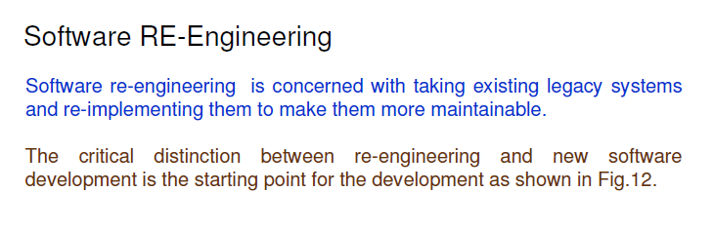

Slide 27
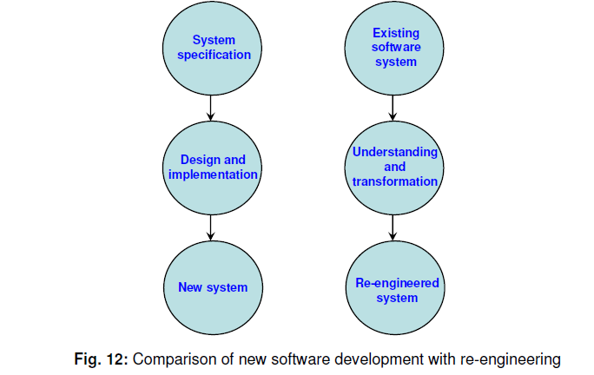

Slide 28
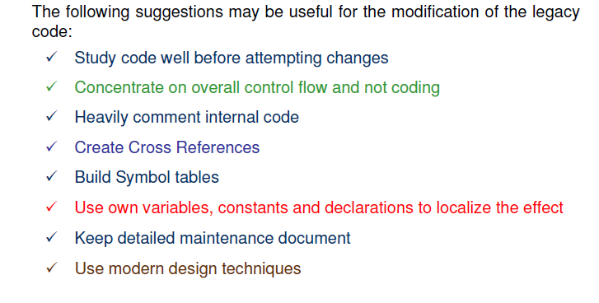

Slide 29
Software Re-engineering involves:
Source Code translation
Program Translation

